Slide 1

Welcome to amazon web services
Presented By :- Mr. SURYADEV CHAUDHARY

Slide 2
identity and access management (Iam)

Slide 3
What is iam?
AWS Identity and Access Management (IAM) is a web service that helps you securely control access to control AWS resources.
IAM, centrally manage permissions that control users access

Slide 4
Authentication
A principal must be authenticated (signed in to AWS) using their credentials to AWS.
To authenticate from the console as a root user, you must sign in with your email address and password

Slide 5
Authorization
You must also be authorized (allowed) to complete your request.
It uses the policies to determine whether to allow or deny the request.

Slide 6
Iam features
Shared access to your AWS account
Multi-factor authentication (MFA)
Free to use

Slide 7
Who uses iam?
Service user
Service administrator
IAM administrator

Slide 8
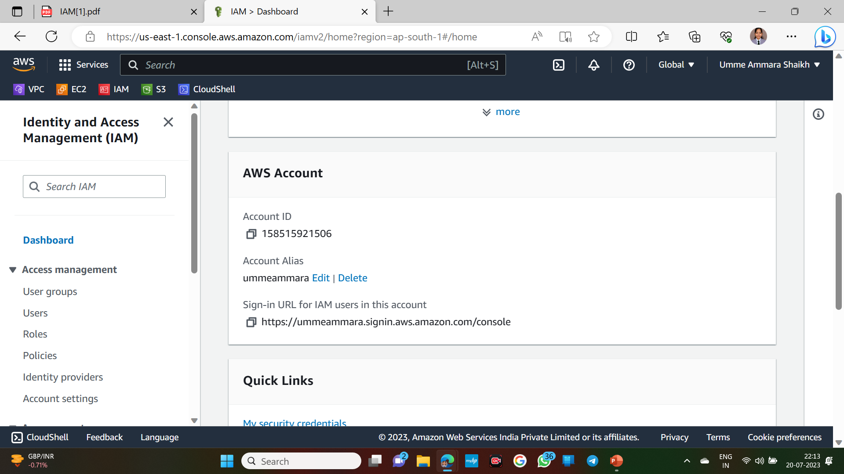




Aws user login

Slide 9
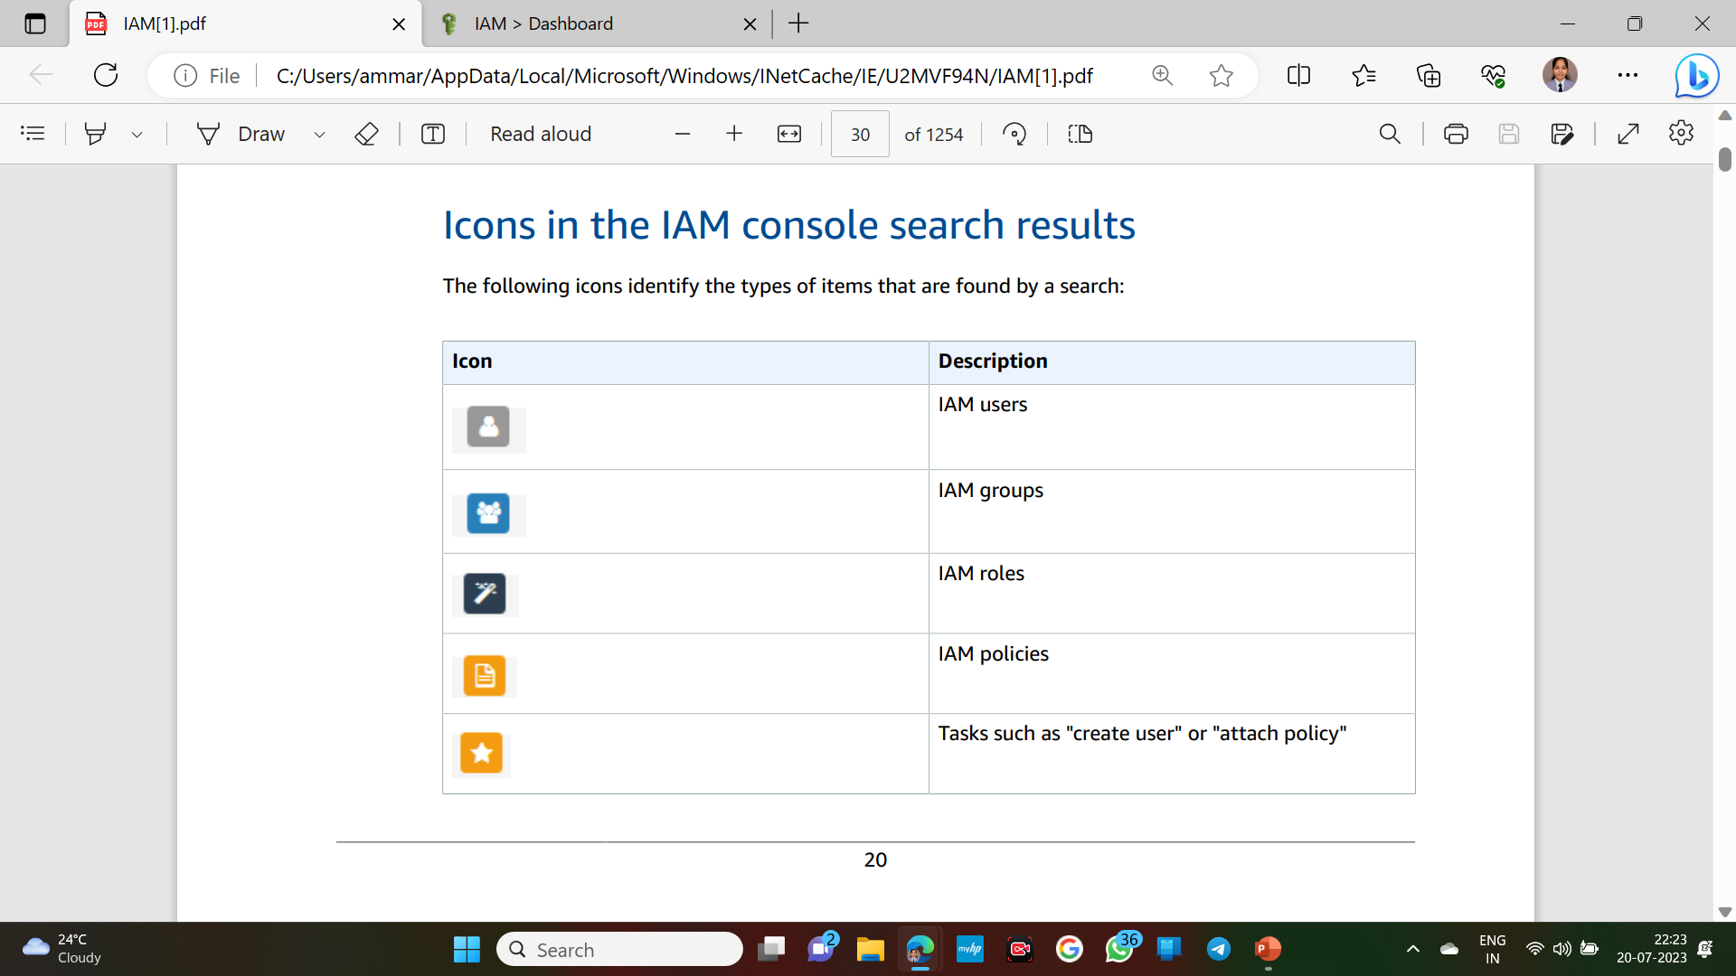
IAM resources
Resources in this AWS Account

Slide 10
User groups
An IAM group is an identity that specifies a collection of IAM users.
You can't sign in as a group
You can use groups to specify permissions for multiple users at a time

Slide 11
user
An IAM user is an identity within your AWS account that has specific permissions for a single person or application

Slide 12
roles
An IAM role is an identity within your AWS account that has specific permissions.
It is similar to an IAM user, but is not associated with a specific person

Slide 13
policies
You manage access in AWS by creating policies and attaching them to IAM identities (users, groups of users, or roles) or AWS resources.
A policy is an object in AWS that, when associated with an identity or resource, defines their permissions.

